Slide 1
UC Davis Sustainability Programs

Slide 2
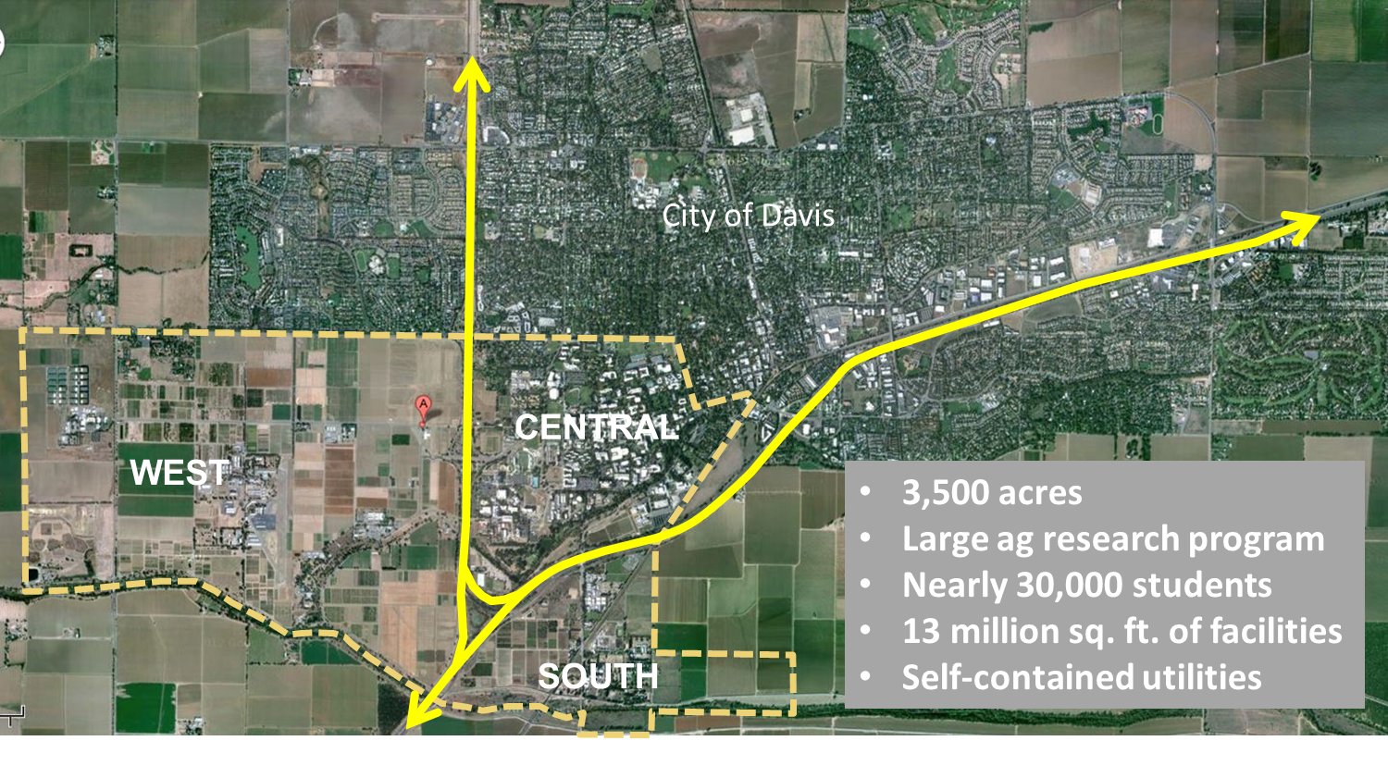
Campus Overview

Slide 3
UC Sustainability Policy
Green Buildings
Clean Energy
Climate Protection
Sustainable Transportation
Sustainable Building Operations
Waste Management & Recycling
Preferable Purchasing Practices
Foodservices Practices
Landscape & Water

Slide 4
Green Buildings
Goals
Out perform Title 24 by at least 20% strive for 30%
Campus goal – 25% strive for 30%
LEED Silver or better new construction
LEED Registered or better for large renovations
Status
LEED Platinum
Gallagher Hall and Conference Center
Gladys Valley Hall
Student Community Center
Tahoe Center for Environmental Sciences
Teaching & Research Winery and Food Science Laboratory
LEED Gold
Coffee House renovation (CI)
Cuarto Dining Commons (CI)
Robbins Hall renovation (CI)
Student Health and Wellness Center
Tercero Student Housing: Wall, Campbell & Potter Halls

Slide 5
Green Buildings
Challenges
Modular buildings
Carbon footprint of new buildings
Occupant behavior
Sustainable operation of existing buildings
In progress/Next steps
Additional buildings awaiting certification
LEED Existing Building Operation & Maintenance (EBOM)
6 buildings registered
Green workplace program
Notes:
With master site credits and “repeatable” credits already in template form, we will have about 30% of the credits documented to reach gold certification for any building on campus and using the LEED EBOM 2009 system. We have the student expertise to document most of the additional credits.
The following buildings are under construction or in planning:
Emerson Hall and Webster Hall (Existing Buildings)
Foundation Plant Services Annex (New Construction)
King Hall expansion (New Construction) and renovation (Commercial Interiors)
Respiratory Disease Center (New Construction)
South Valley Animal Health Laboratory (New Construction)
Tercero Student Housing Phase 3 (New Construction)
Veterinary Medicine 3B (New Construction)
LEED EBOM BUIDLINGS
Giedt Hall
Mathematical Sciences Building
USDA Western Human Nutrition Research Center
Hutchison Hall
Mrak Hall
Sciences Laboratory Building

Slide 6
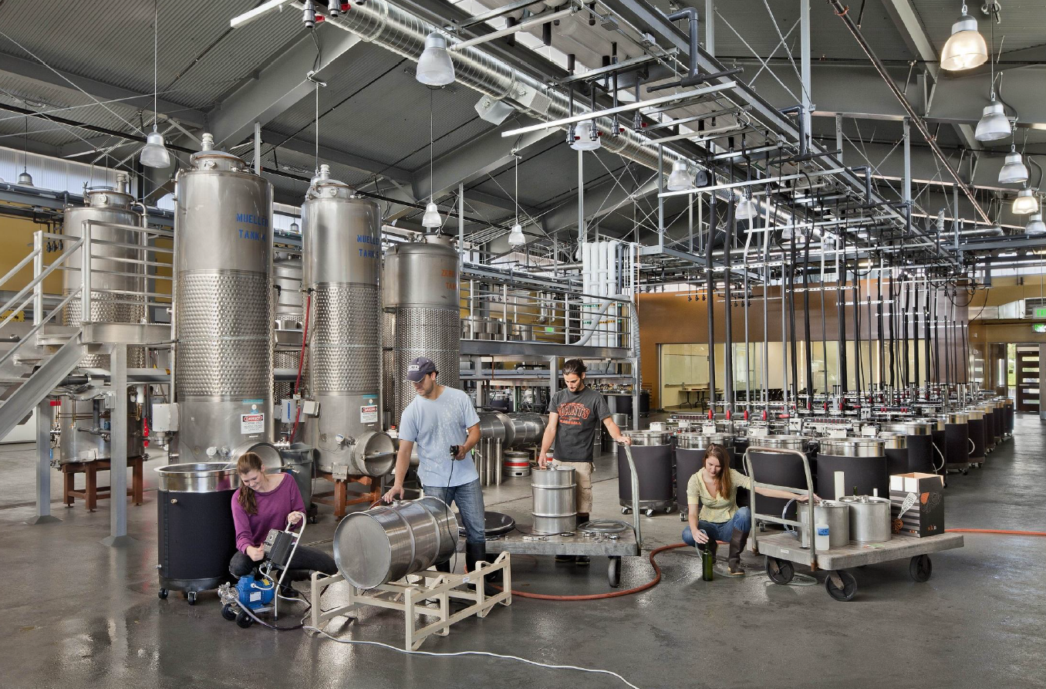
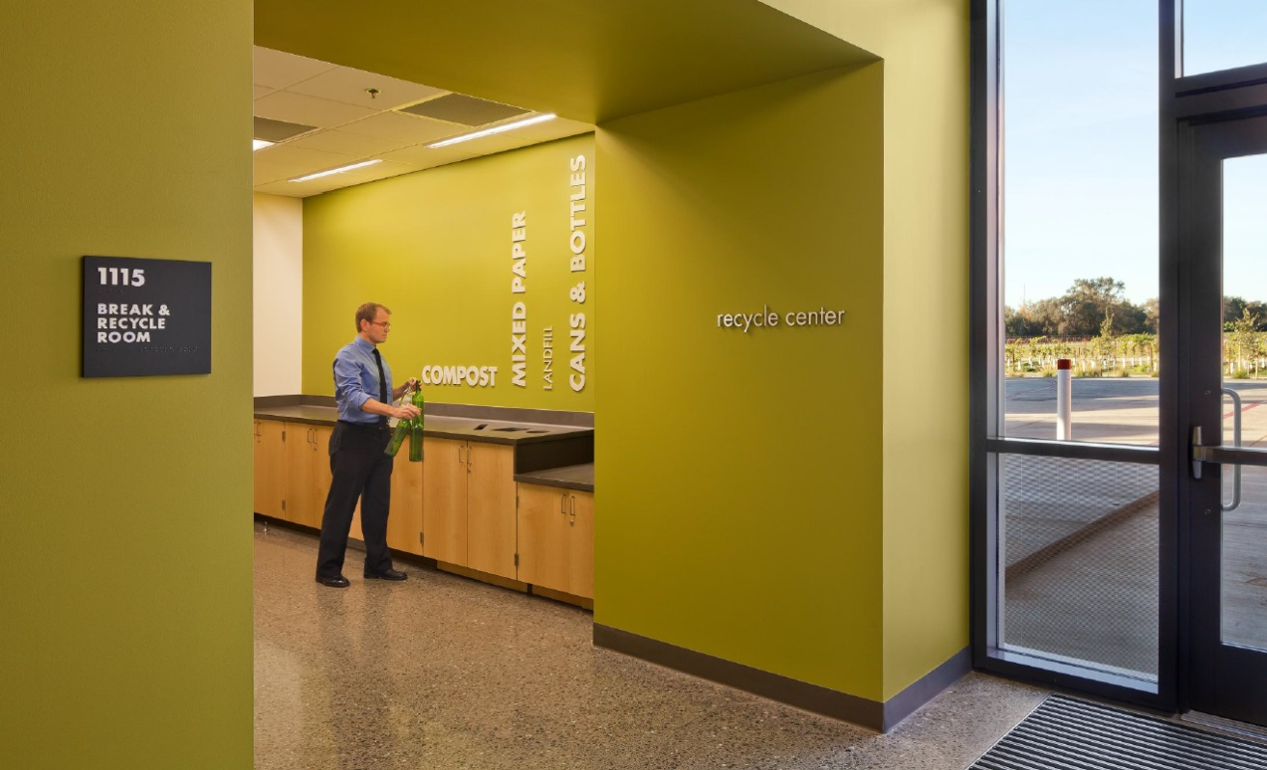
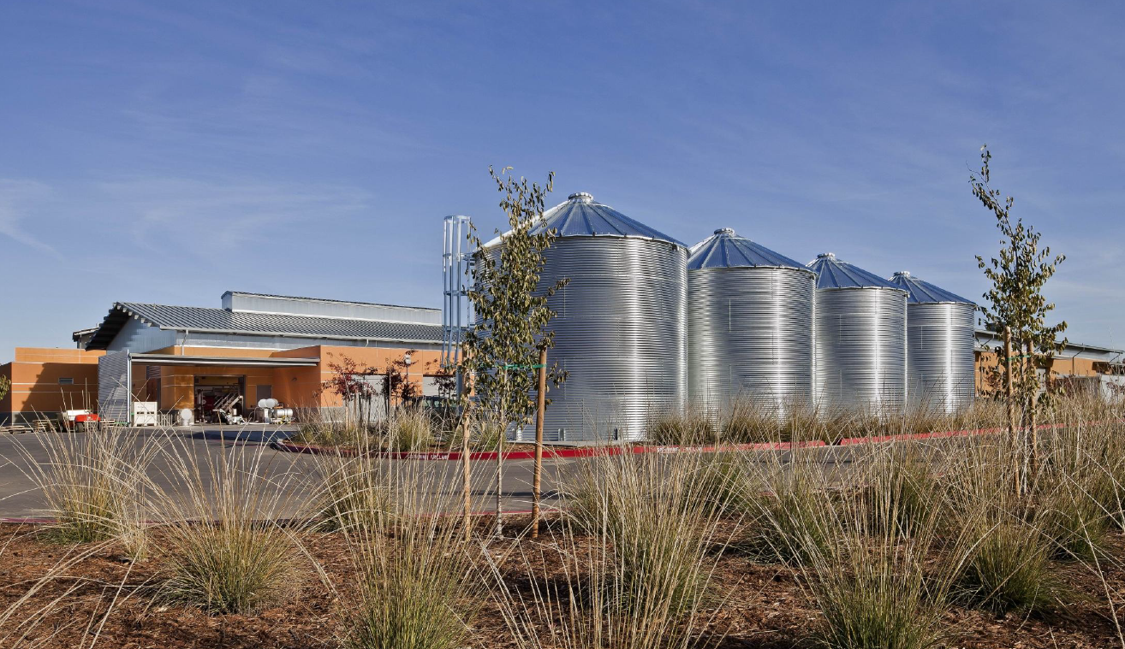
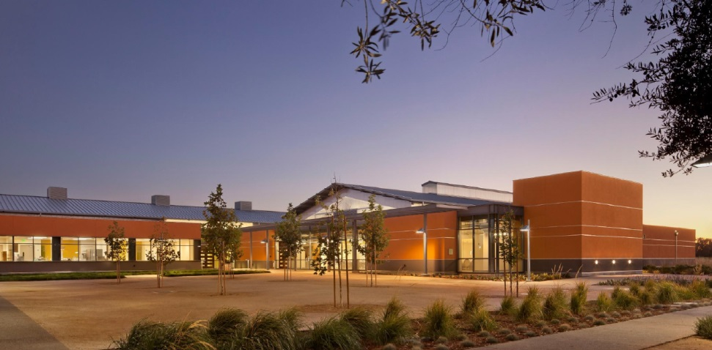
Winery, Brewery & Food Science
Industry Leader
LEED Platinum
Water recapture and reuse
Carbon sequestration
Notes:
With master site credits and “repeatable” credits already in template form, we will have about 30% of the credits documented to reach gold certification for any building on campus and using the LEED EBOM 2009 system. We have the student expertise to document most of the additional credits.
The following buildings are under construction or in planning:
Emerson Hall and Webster Hall (Existing Buildings)
Foundation Plant Services Annex (New Construction)
King Hall expansion (New Construction) and renovation (Commercial Interiors)
Respiratory Disease Center (New Construction)
South Valley Animal Health Laboratory (New Construction)
Tercero Student Housing Phase 3 (New Construction)
Veterinary Medicine 3B (New Construction)
LEED EBOM BUIDLINGS
Giedt Hall
Mathematical Sciences Building
USDA Western Human Nutrition Research Center
Hutchison Hall
Mrak Hall
Sciences Laboratory Building

Slide 7
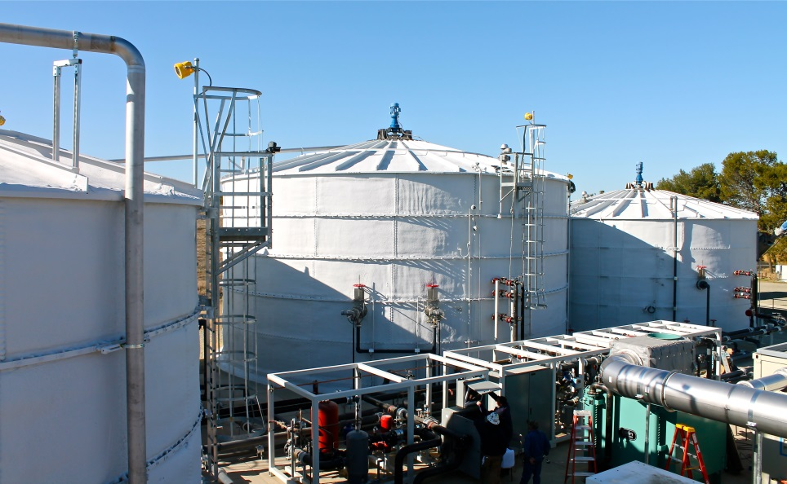
Clean Energy
Goals
UC to provide 10,000 kilowatts of on-site renewables by 2014
Status
782 kilowatts solar at UC Davis
4,000 kilowatts solar as part of West Village multifamily
145 kilowatts solar at UC Davis Medical Center
Renewable Energy Anaerobic Digester – 800 kilowatts

Slide 8
Biodigester Project
Increase renewable energy supplies
5.6 million kWh per year
Reduce greenhouse gas emissions
Electricity ≈ 4,000 metric tons CO₂e
Feedstock emissions ≈ 6,000 metric tons CO₂e
May be able to count some credit towards cap-and-trade allowances
Reduce waste sent to municipal landfills
50 tons/day year from the region (20,000 tons/year)
20 tons/day from campus
Support commercialization of UC Davis green technology
CLIMATE PROTECTION

Slide 9
Clean Energy
Challenges
High cost of renewable energy
Low cost of WAPA power
In Progress/Next Steps
Big solar project – approximately 14,000 kilowatts

Slide 10
Climate Protection
Goals
2000 greenhouse gas emissions by 2014
1990 greenhouse gas emissions by 2020
University of California a zero net energy consumer by 2025
Climate neutral as soon as possible
≈ 2050 or earlier
Status
CLIMATE PROTECTION

Slide 11
GHG Sources
CLIMATE PROTECTION

Slide 12
GHG Location
CLIMATE PROTECTION

Slide 13
How are we doing?
CLIMATE PROTECTION

Slide 14
Annual Energy Savings due to Energy Efficiency Projects from 2009 to 2012
Notes:
This graph demonstrates utility-verified energy savings from energy efficiency projects between 2009 and 2012 for each campus and Medical Center in the Energy Efficiency Partnership, plus self-reported energy savings from UCLA’s and UCLA Medical Center’s energy efficiency projects, which have mostly been done independently from the Partnership. These projects include energy efficiency measures instituted in new buildings in addition to retrofits and building re-commissioning in existing buildings.
While the Partnership started in 2004, showing savings since 2009 captures approximately 86 percent of the savings to date. [Note: good data is not available prior to 2009]
Energy efficiency implementation at the medical centers has been limited to date, with the notable exception of UCSF. The other medical centers are in the process of developing energy efficiency programs and should show increased activity in the next two years.
[NOTE: UCLA , UCR, and UC Davis Med Center are served by municipal utilities and are not part of the Energy Efficiency Partnership. UC Merced is a new campus and is only recently beginning to make further energy efficiency improvements to its already very efficient new buildings. Riverside, Merced, and Davis Med Center were not included in this graph.]

Slide 15
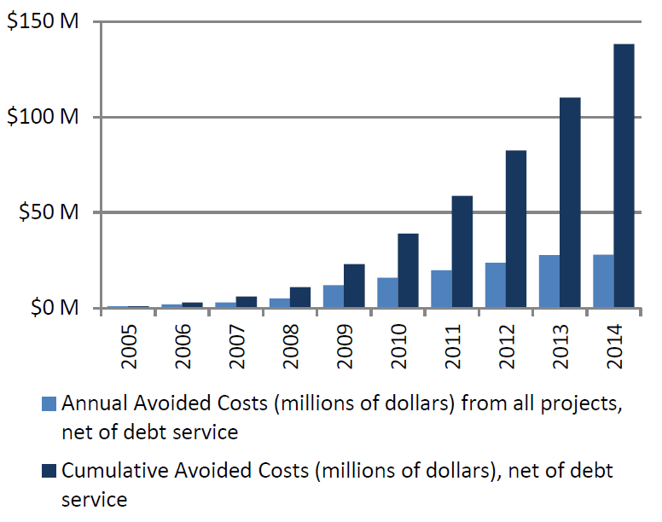
Cost Avoidance through Energy Efficiency
Notes:
UC’s Energy Efficiency Partnership with utility companies, established in 2004, allows the university to invest in energy efficiency projects that generate significant operational savings.
Projects include lighting retrofits, building re-commissioning, and upgrades to heating, ventilation, and air conditioning– all reduce energy consumption AND improve comfort, health, and safety.
The University received $18.9 million of incentives from the Partnership in 2012 to implement 184 projects. Those projects are projected to save approximately 59 million kilowatt-hours of electricity and 5 million therms of natural gas. Net of debt service, these projects will save approximately $5 million annually in avoided utility costs.
Since the program began, UC’s cumulative net avoided costs from these energy efficiency projects is approximately $91 million. Projects completed in 2012 will increase the annual net avoided utility costs to approximately $37 million in 2013. By the end of 2013, cumulative savings since 2004 will reach approximately $128 million.

Slide 16
Smart Lighting Initiative
Reduce lighting energy consumption 60% below business as usual by 2015
Create a reference site for others
Fund with incentives and energy savings
Link California Lighting Technology Center programs with campus goals

Slide 17
Smart Lighting Initiative

Slide 18
Climate Protection
Challenges
Campus growth
2020 Initiative
2030 Long Range Development Plan
Cap-and-trade expenses
Scope 3 emissions
Commuter emissions
Air travel
Agricultural emissions
Drought
CLIMATE PROTECTION

Slide 19
Climate Protection
In progress/Next steps
Statewide Energy Partnership Program
Smart Lighting Initiative
Renewable energy projects
2020 Climate Action Plan Task Force
Purchase of carbon credits as part of cap-and-trade program
Selecting a target year for climate neutrality
Future?
Decentralized energy bills
Space charges
Systemwide Biogas Option
CLIMATE PROTECTION

Slide 20
Waste Reduction & Recycling
Goals
Prioritize efforts in the following order
Reduce
Reuse
Recycle
50% diversion by 2008
75% diversion by 2012
Ultimate goal of zero waste by 2020
Zero waste = 95% diversion?
Status

Slide 21
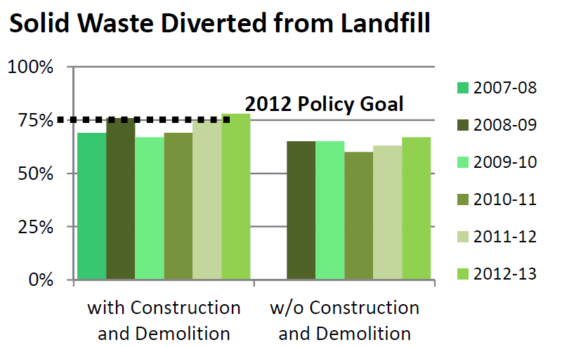
Waste Reduction & Recycling

Slide 22
Waste Reduction & Recycling
Challenges
Achieving 75% without construction & demolition
Waste that arrives as packaging
Primate center gravel – accounts for 1/3 of landfilled waste by weight
Campus landfill closed in 2011

Slide 23
Waste Reduction & Recycling
In Progress/Next Steps
Waste Management Planning Committee
Campus audit
Measurement of effectiveness of mini-bin program
Purchasing subcommittee
Increase organics and compostable collections
Evaluation of current operations/funding sources
Zero waste events
Recycling/compostable collections
Additions or consolidation of different waste streams

Slide 24
Water
Goals
Reduce per capita potable water use 20% by 2020
Select campus appropriate baseline year
1996-1999
Status
WATER

Slide 25
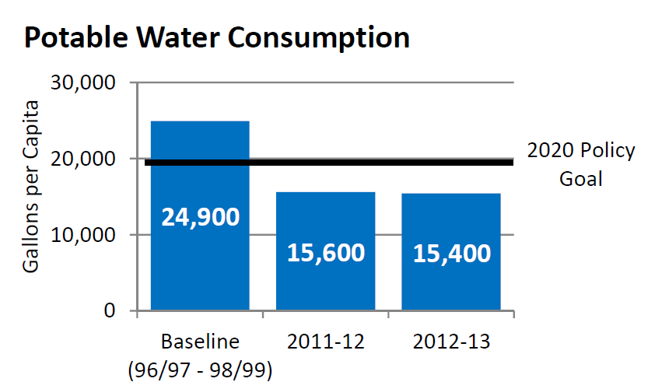
Domestic Water Use
WATER

Slide 26
Domestic Water Use
Challenges
Campus growth
Addition of West Village
Future large water-using research program
In Progress / Next Steps
Project to redefine the campus landscape
Preparation of water action plan
Drought Action Plan
WATER

Slide 27
Sustainable Food Purchases
Goals
Procure 20 % sustainable food products by 2020 for campus foodservice operations
Certify at least one foodservice facility on each campus as a green business
Educate both patrons and foodservice staff about sustainable food products and sustainable operation.
Status

Slide 28
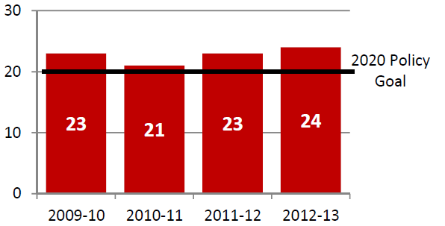
Sustainable Food Purchases
Residential Dining

Slide 29
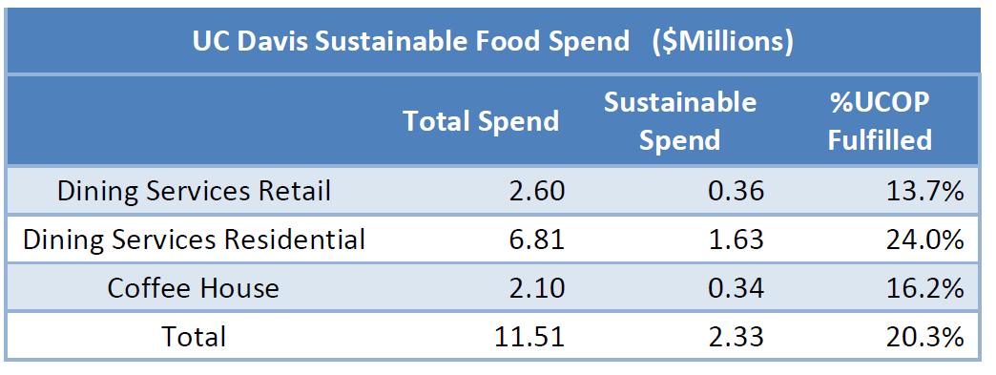
Sustainable Food Purchases
Challenges
Next Steps
Establish campus stretch goals

Slide 30
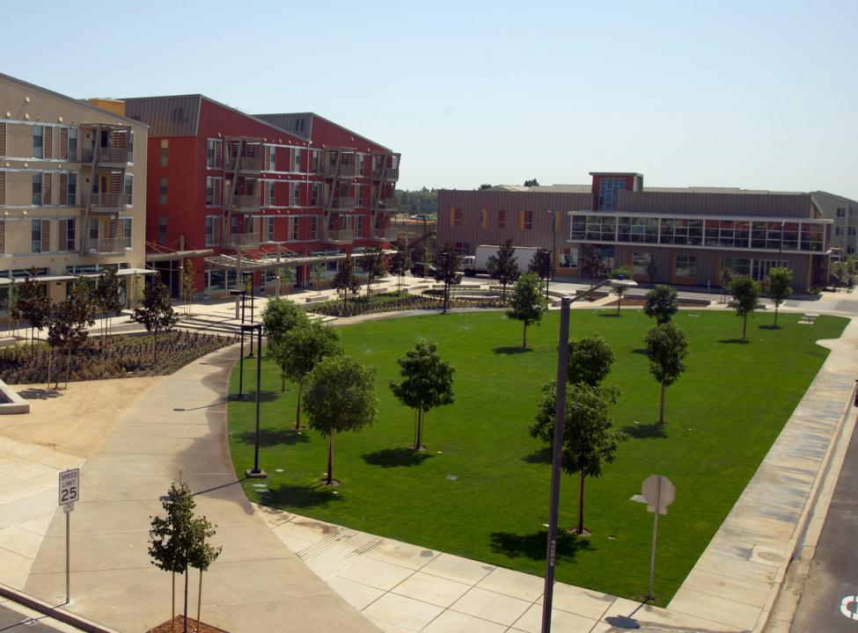
UC Davis West Village
The largest planned "zero net energy" community in the United States

Slide 31
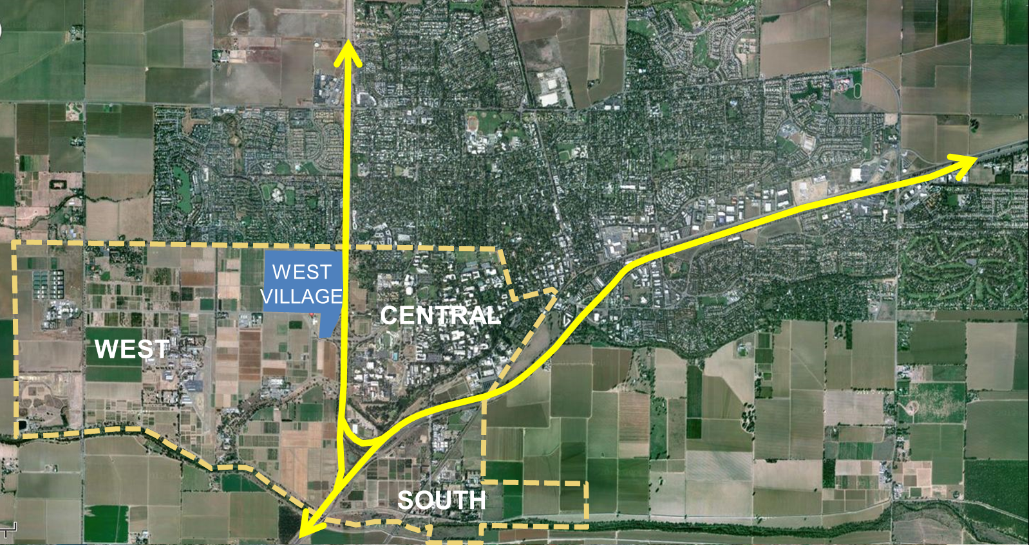

Slide 32
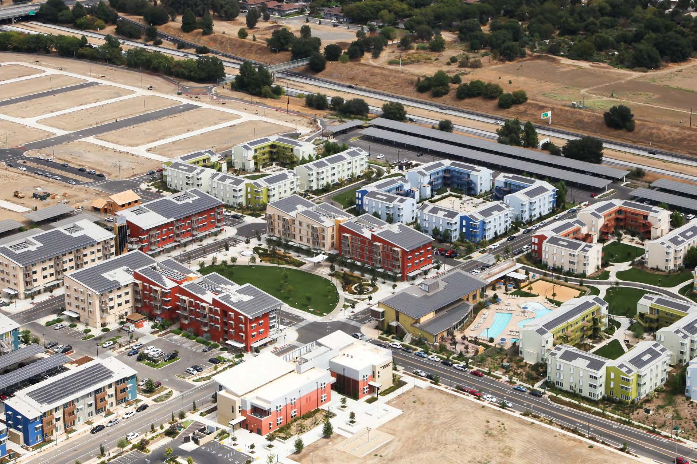
662 apartments
343 single family homes
42,500 sq. ft. of commercial space
60,000 sq. ft. Community College

Slide 33
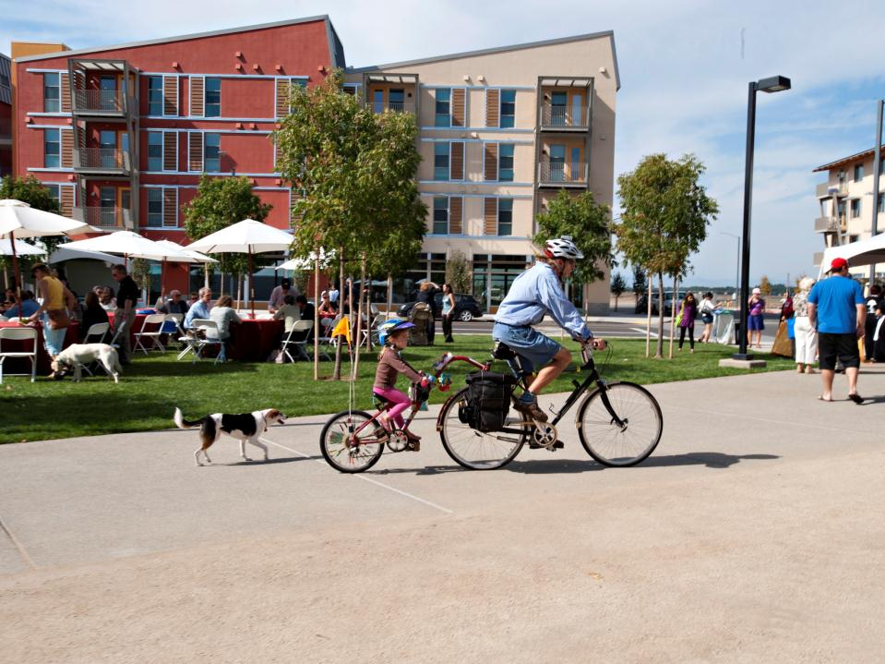
Project Goals
Livable
Affordable
Environmentally responsive

Slide 34
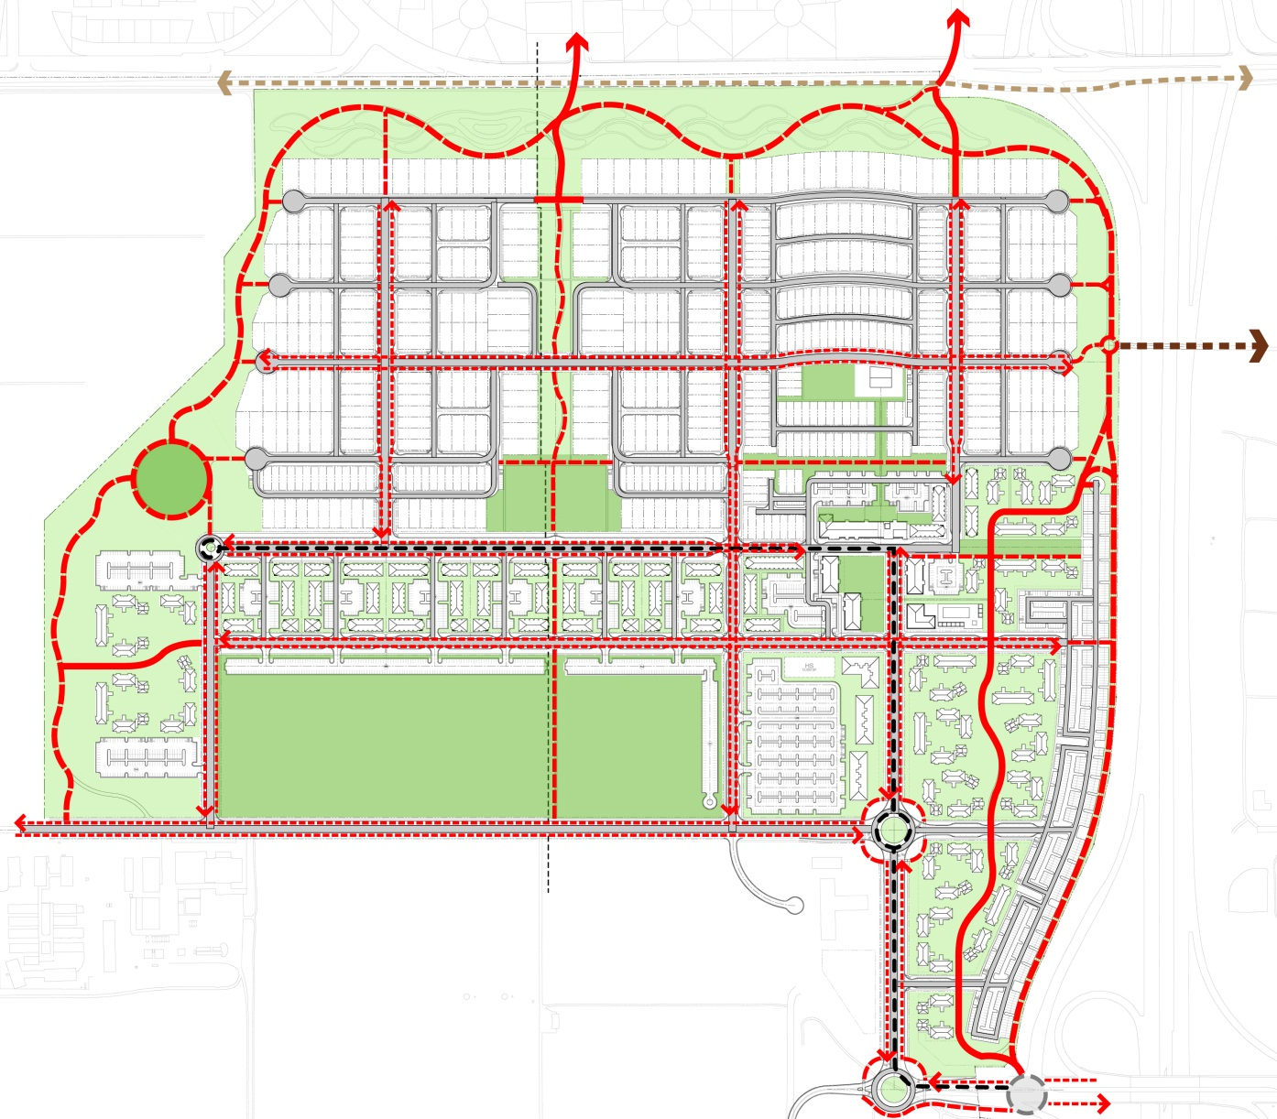
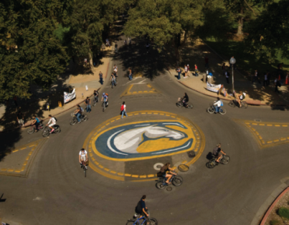
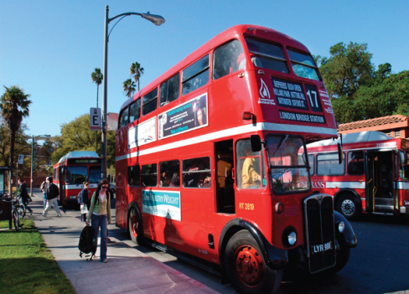
Environmental Responsiveness

Slide 35
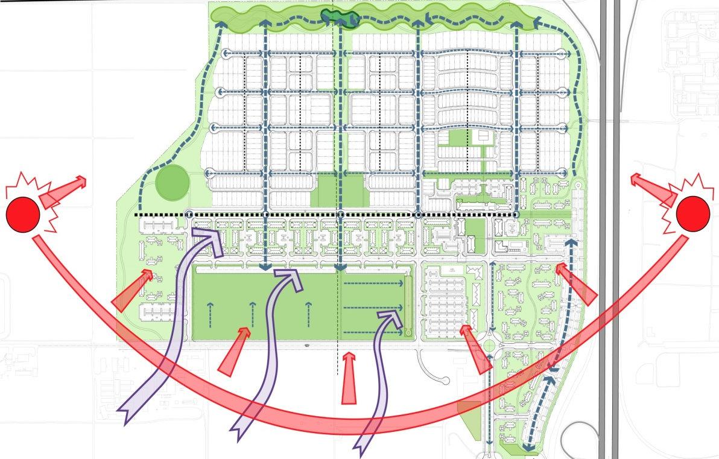
Environmental Responsiveness

Slide 36
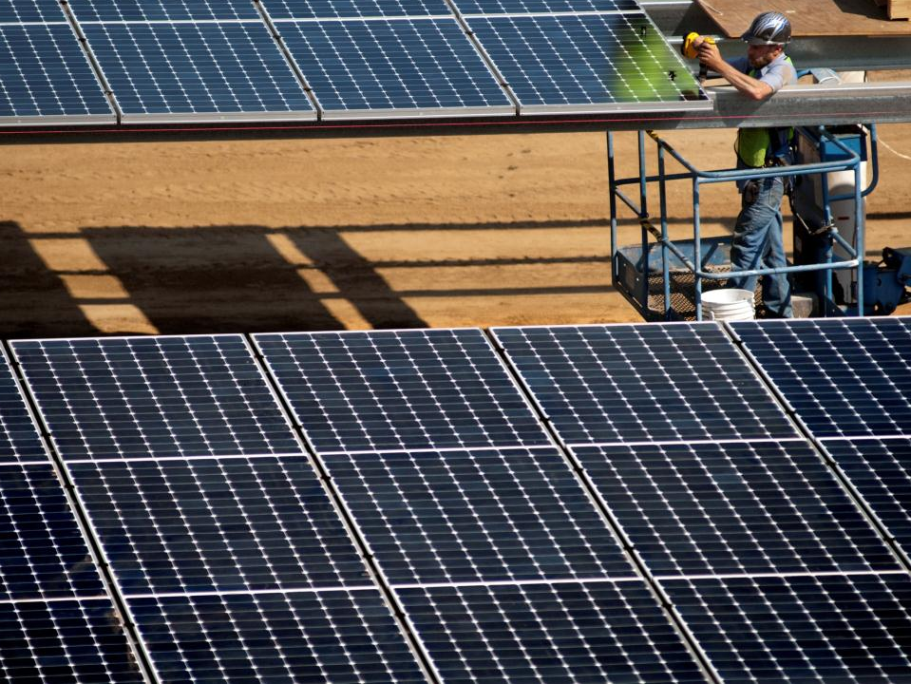
Energy Goals
Zero Net Energy Use

Slide 37
West Village Energy Initiative
Program Goals
Zero Net Energy from the Grid annually
No higher cost to the consumer
No higher cost to the developer
Deep Energy Conservation Measures

Slide 38
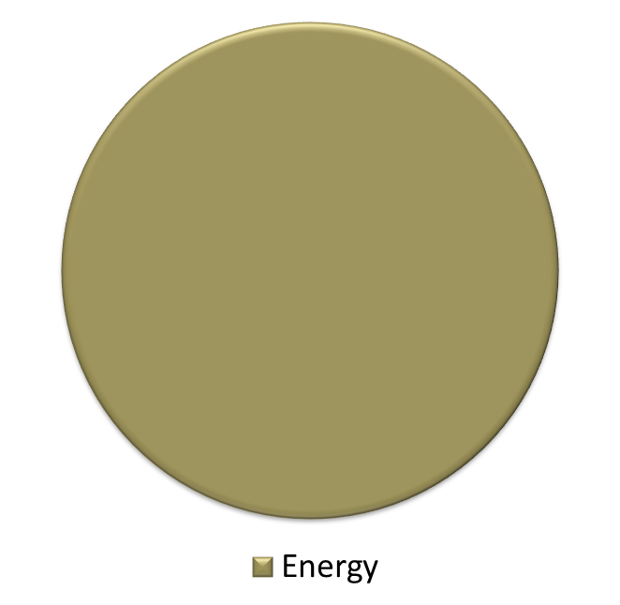
Energy Spend - Typical
$
$
Energy Efficiency Measures

Slide 39
Energy Spend – West Village
$
$
Energy Efficiency Measures

Slide 40
West Village Energy Initiative
Status
All apartments completed and occupied
Nearly 4 megawatts of solar panels installed
For March 2012 through February 2013
Production = 87% of consumption
Lessons learned
Commissioning issues
Modeling assumptions
Occupant behavior variability

Slide 41
Case for Sustainability
Fulfill public policy goals
Cost savings
Energy use
Water use
Waste reduction
Academic-Staff Linkages
West Village Energy &Transportation Hub
Brand recognition
Sierra Magazine #1 ranking
#9 in GreenMetric World University Ranking
STARS gold

Slide 42
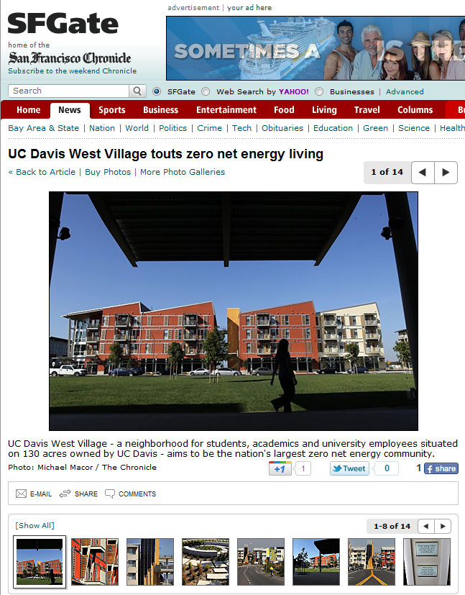
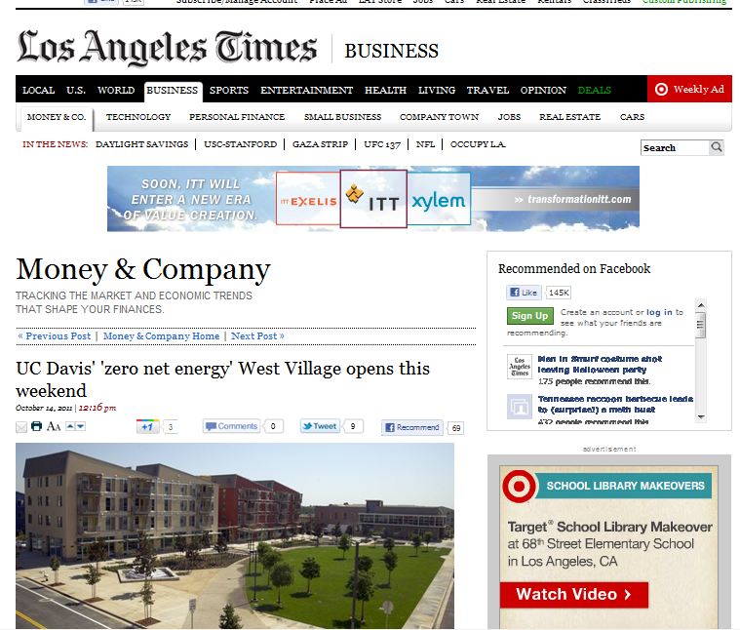
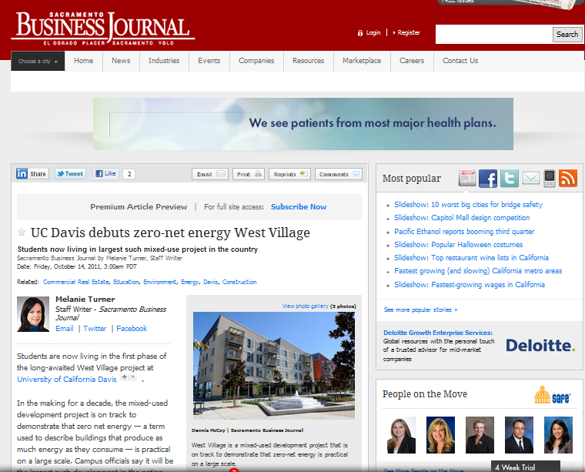
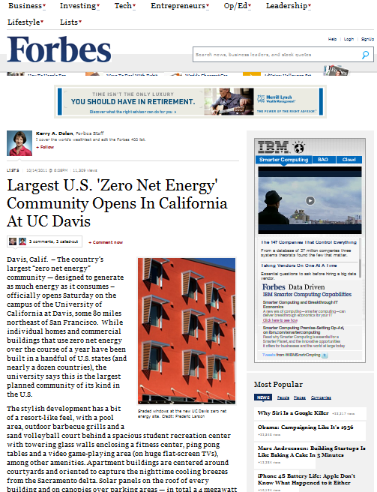
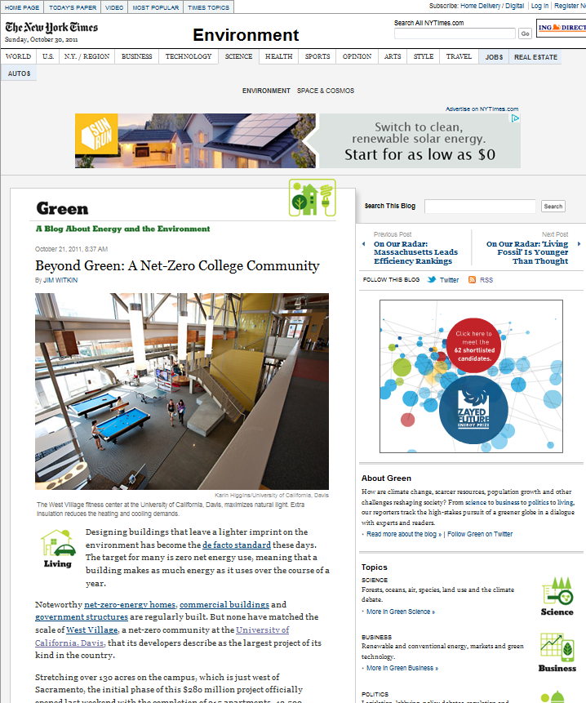
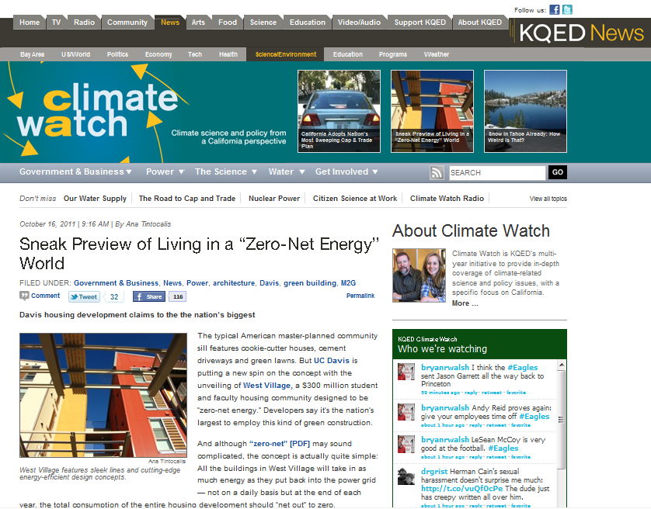
West Village Press

