Slide 2
“The greater danger for most of us lies not in setting our aim too high and falling short…but in setting our aim too low, and achieving our mark”
Michelangelo

Slide 3
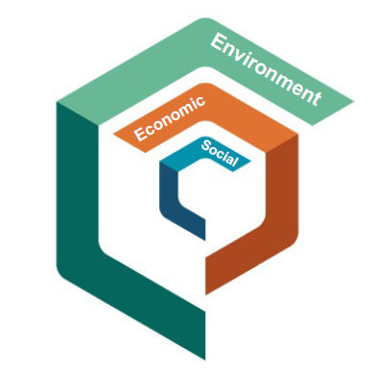
Introduction
The Sustainable City (TSC) is a practical implementation of social, economic and environmental (SEE) sustainability. The City embodies the true meaning of sustainable living through stakeholder engagement, innovative design and future monitoring to sustain itself.
TSC comprises various land-uses such as residential, commercial, educational, urban farming, leisure, healthcare and The Sustainability Center of Excellence.

Slide 4
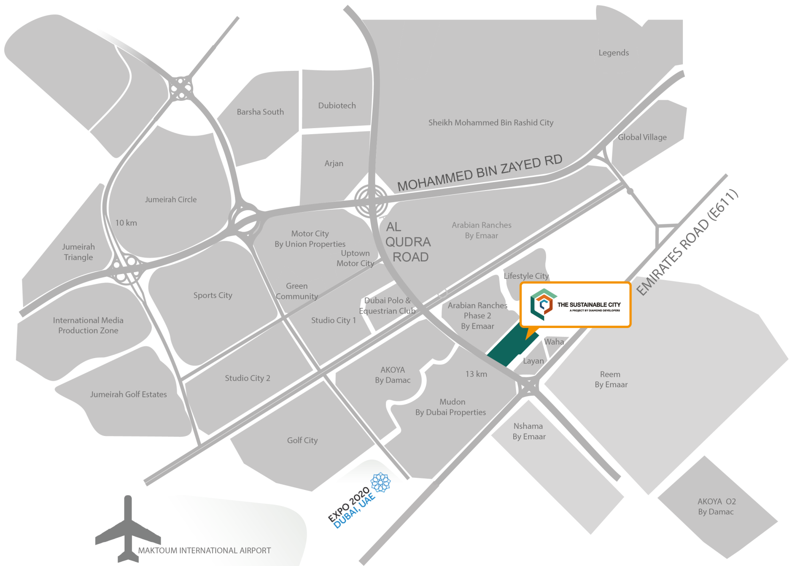
Location
General information:
46 hectares
Located in Dubailand on Al Qudra Road
20 minutes drive to Al Maktoum International Airport and the Burj Al Arab Hotel

Slide 5
The Sustainable City

Slide 6
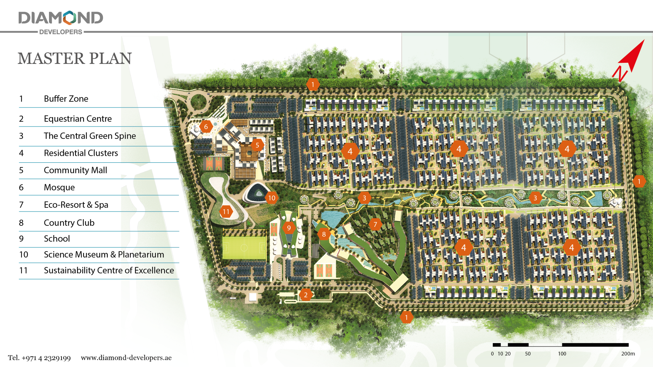

Slide 7
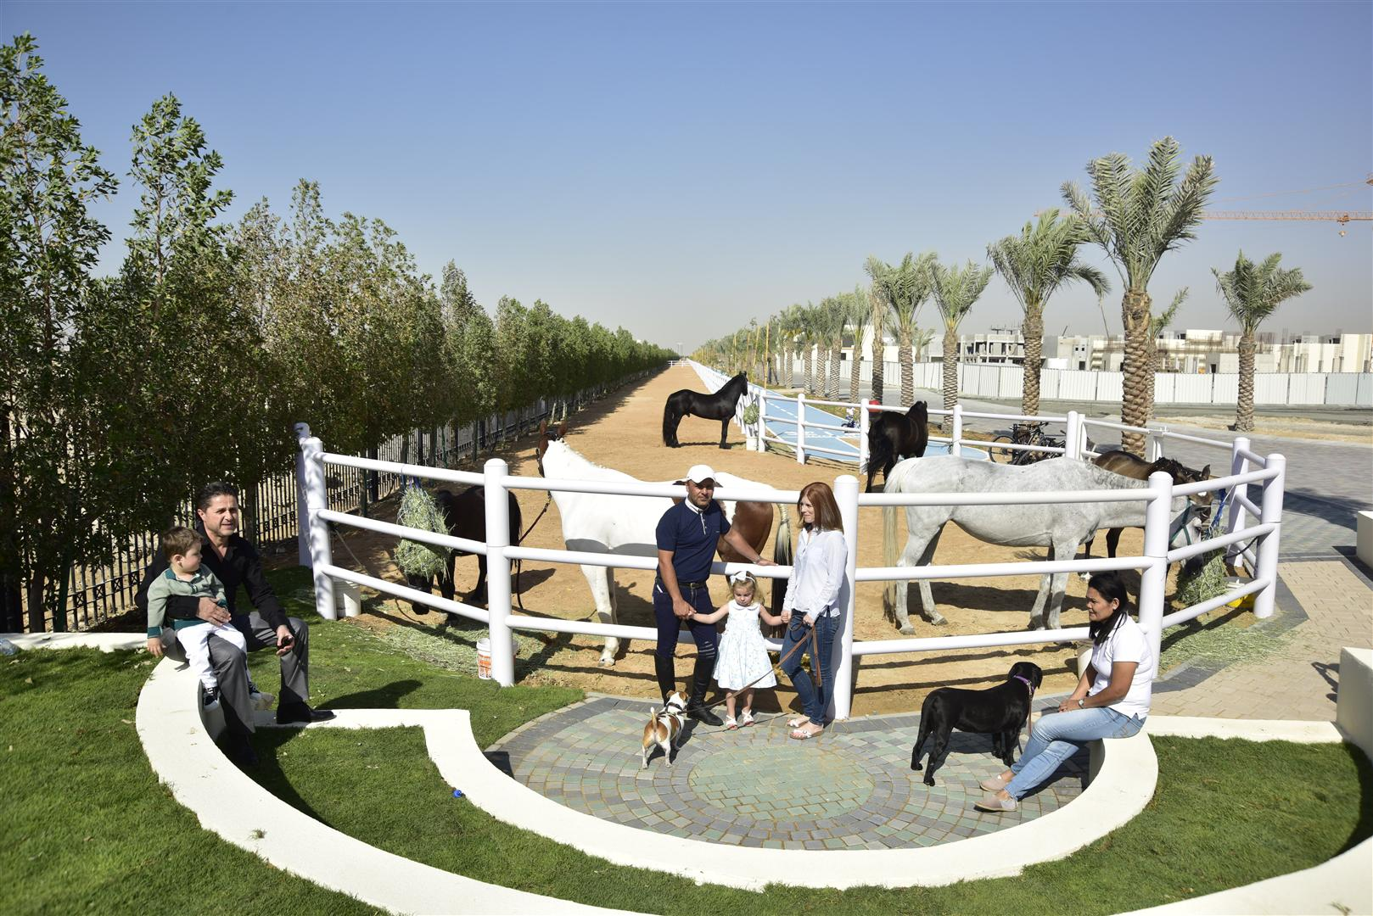
1. The Buffer Zone
General information:
27m wide, surrounding the community
Reduces air & noise pollution
Barrier to dust
Provides shade
Enhances air quality
Consists of:
4 layers of 2500 trees, 10m in height
Shaded two-way 4km horse track
Shaded two-way 4km cycle track
Shaded 3km rubberized walking track
A bio-swale collecting storm water runoff for recycling & reuse
Additional 1000 date palm trees on both sides of outer perimeter ring-road.

Slide 8
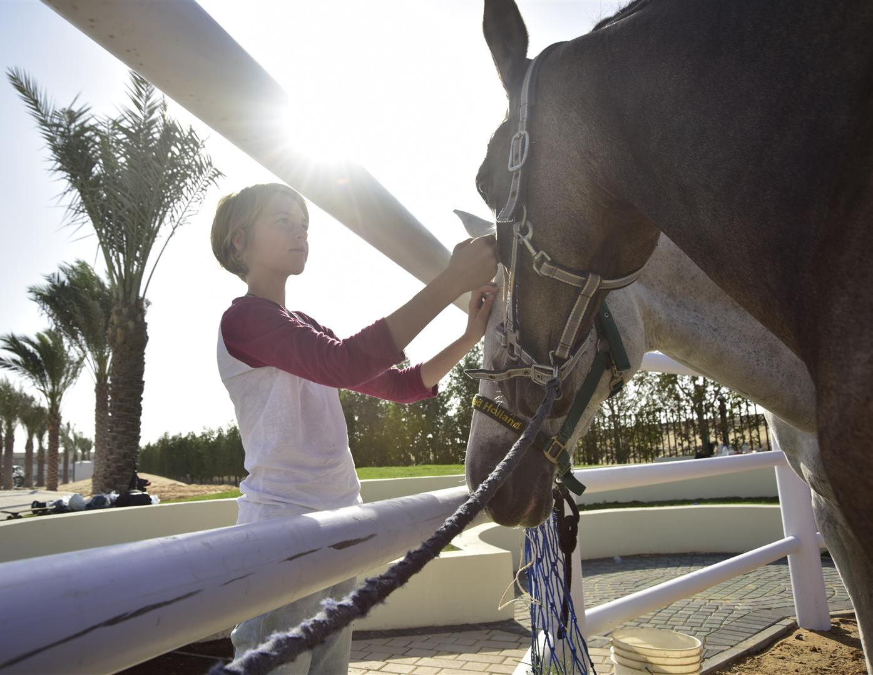
2. The Equestrian Center
General information:
4,400 sq. m land area
32 stable stalls
Activities include:
Horse riding lessons
Horse jumping and beauty shows
City horse carriage tours

Slide 9
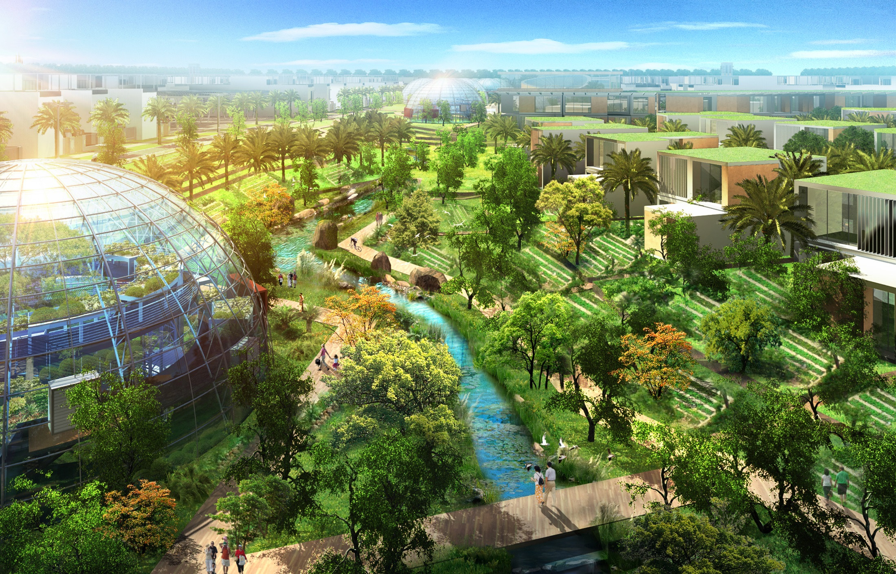
3. The Central Green Spine

Slide 10
3. The Central Green Spine
General information:
36,000 sq. m
Productive landscapes
Urban farming
Outdoor sports & recreation
Recycled water irrigation systems
Consists of:
1km rubberized jogging track
5 outdoor fitness, yoga & sport stations
Multiple shaded seating areas
Community swimming pool & gym with associated amenities
Two 100% recycled water lakes connected
by a stream with bridge crossings, waterfalls
& fountains to irrigate the trees
A traditional Falaj water irrigation system
3000 productive trees that include:
Palm
Citrus
Mango
Papaya
Pomegranate
Figs

Slide 11
3. The Central Green Spine
The 11 Biodomes:
Naturally ventilated
7m in height
300 sq. m each
Growing herbs, vegetables & fruits
Priority to residents
Surplus sold at Friday Community Market
Herb production will meet total residents’ needs
.

Slide 12
4. The Residential Clusters
General information:
5 clusters, 100 units each = 500 units total
Connected to Central Green Spine
Fully gated and monitored for safety and security
Each cluster divided into 16 lots of 3 & 4 bedroom courtyard & garden villas.
Solar shaded parking areas function to:
generate power for outdoor LED lighting
charge electrical cars & golf carts
10 to 100m distance between parking area & villas
2 allocated car parking spaces & 2 allocated golf cart spaces for each villa:
1 golf cart space underneath the solar shaded parking area
1 golf cart space in villa

Slide 13
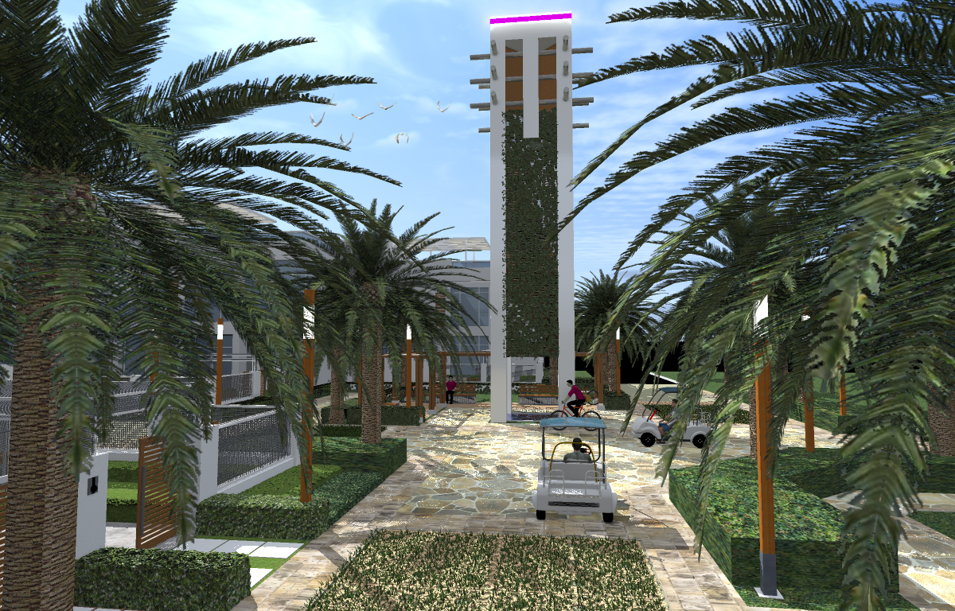
4. The Residential Clusters
Within the clusters:
Sikkas (internal roads) fully pedestrianized
Shaded, safe & car free
Central urban plazas with a barjeel wind tower and electric shuttle stop
4 children play parks per cluster; 1 per 25 villas
Multiple recycling stations

Slide 14
4. Courtyard & Garden Villa
Private, North oriented , L-shaped units with abundant daylight & landscaped garden
Highly insulated UV reflective walls, roof and windows
Accessible solar shaded rooftop terrace overlooking the city
Smart, energy efficient air conditioning system with humidity controls
Energy-Star rated kitchen appliances
Solar water heaters
LED lighting
Water efficient fixtures, faucets & appliances
100% recycling of wastewater in separate grey & black water drainage networks

Slide 15
5. Community Mall
* Home owners enjoy a Net Zero service & maintenance fee scheme from shared revenues of the community mall rentals
General information:
A 15,000 sq m. community mall that comprises:
Shops, cafes & restaurants, on the periphery of an outdoor central plaza
89 rentable apartments:
studios, 1 &2 bedrooms
rent priority to community employees.
Offices
Healthcare clinic
Nursery
Supermarket
Community amenities
Friday Community Market

Slide 16
6. Mosque
General information:
1500 sq. m
Located at the gateway of the city
700 person capacity
Consists of:
Sustainable design strategies:
100% water recycling from ablution areas
LED lighting
High efficiency HVAC with moisture control
UV reflective paint
Solar Water Heaters
Solar shaded parking areas powering outdoor LED lighting

Slide 17
7. Eco-Resort and 8. Country Club
10,000 sq. m Eco-resort with 143 rooms
Offers tourists the opportunity to engage in community urban farming
To host the Sustainability Center of Excellence’s guests, professors and lecturers
The country club will have sports facilities & outdoor courts
Environmentally friendly design:
100% water recycling
LED lighting
High efficiency HVAC with moisture control
UV reflective paint
Solar water heaters

Slide 18
9. School
General information:
8,000 sq. m K-12 green school
1000 students
Sustainable building
High-tech, digitized school
Details:
Progressive curriculum
Students will utilize TSC for interactive learning on:
renewable energy
water recycling
air quality
urban farming
waste management & composting
Access to equestrian center & green spine for P.E.
Various extra-curricular activities available
Outdoor learning

Slide 19
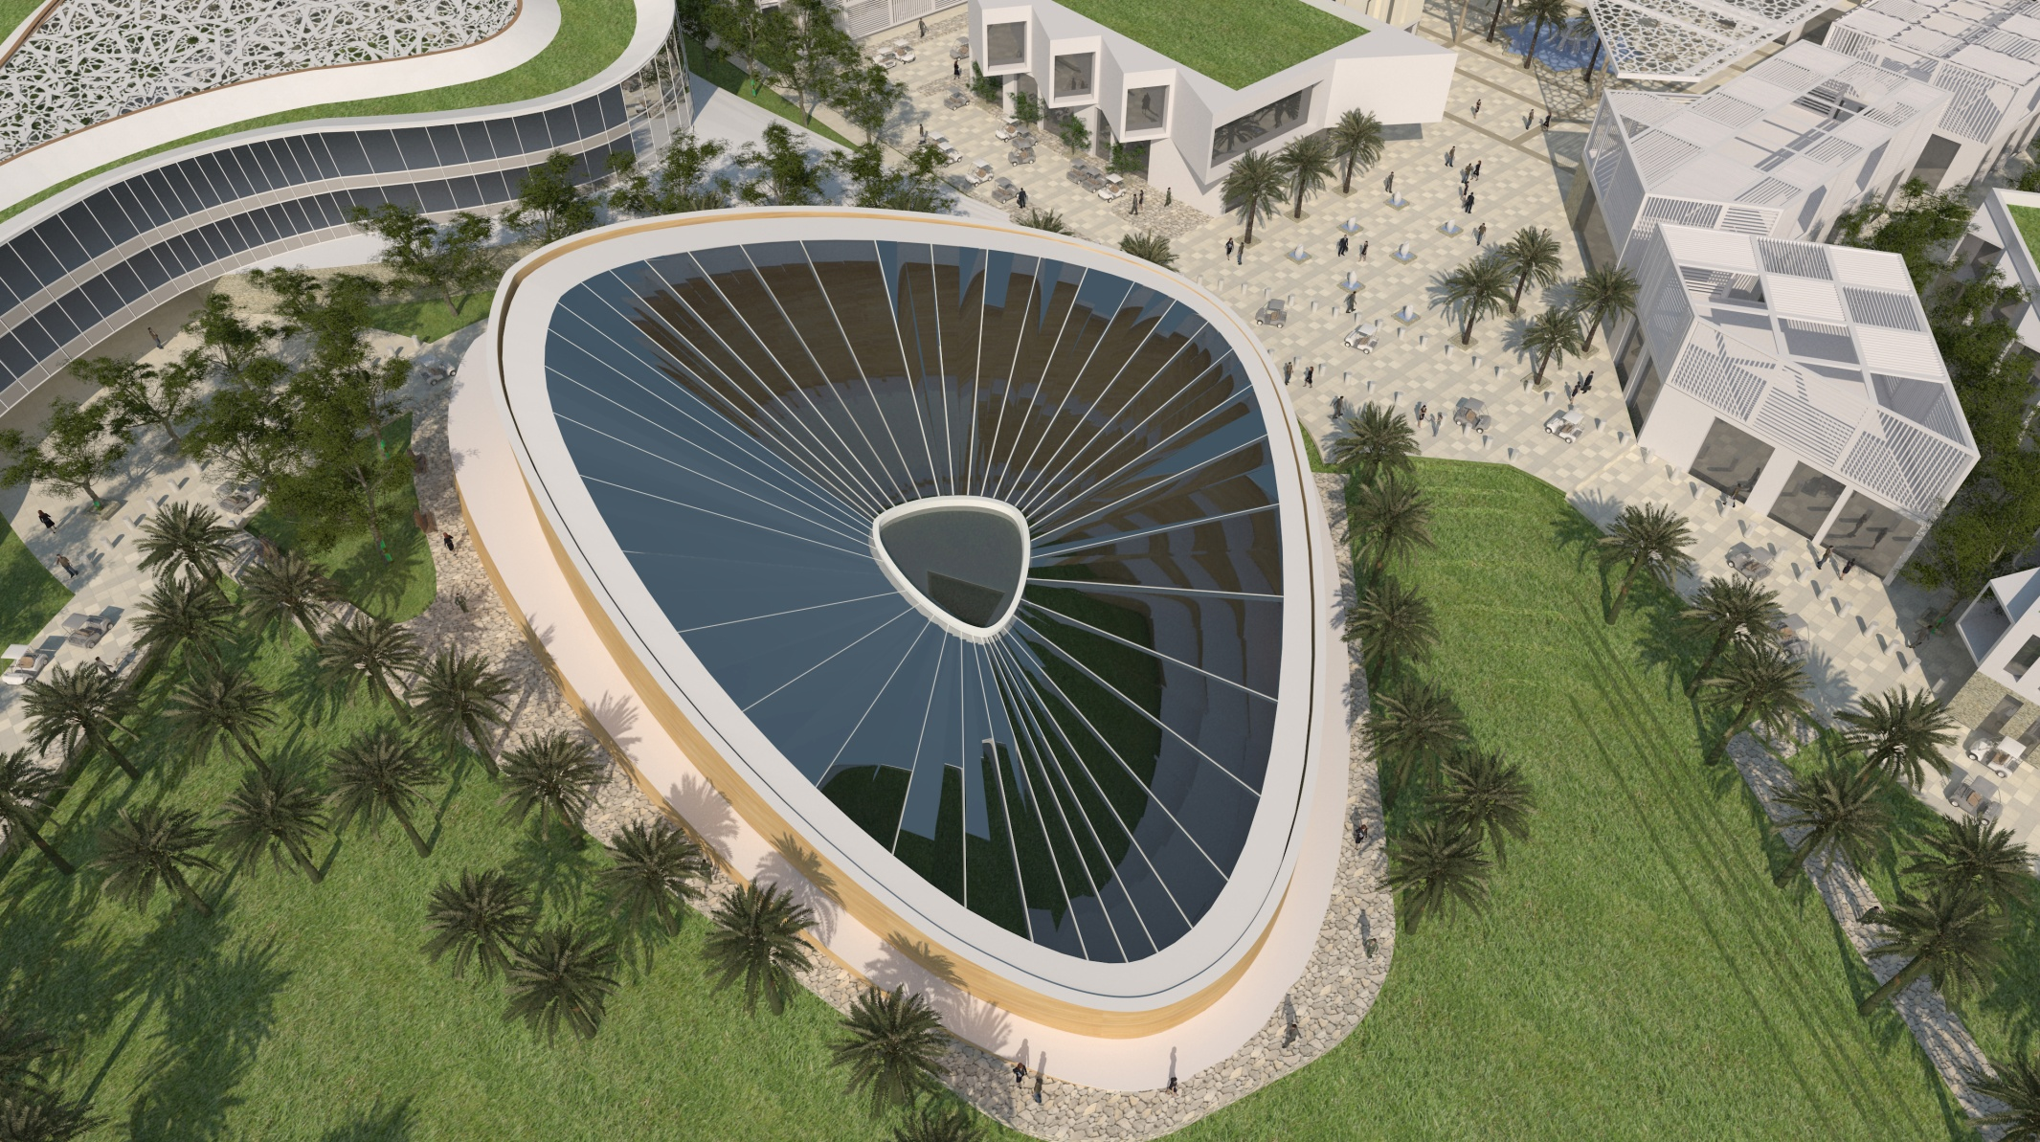
10. Science Museum & Planetarium
A 2,300 sq. m area for both The Science Museum & The Planetarium
The Science Museum:
Indoor & outdoor interactive sustainability exhibits on: energy, water, air, waste & transportation
An observation deck with a 360 degree view of the city
The Planetarium:
10 m in diameter dome
90 person capacity
Screening educational films on sustainability, Planet Earth & the solar system

Slide 20
11. Sustainability Center of Excellence
General information:
10,000 sq. m
World class institution focused on sustainability
Will function as the “brain” to monitor TSC environmental performance
Offering the following activities:
Applied sustainability research
Training courses
Sustainability consulting services
Sustainability exhibitions & conferences
Providing scholarships to students in other universities (B.Sc , M.Sc , PhD)

Slide 21
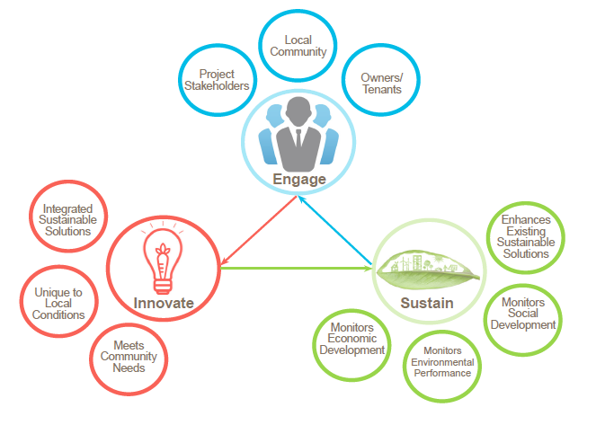
Our Strategy

Slide 22
Energy
Demand Management Strategies – 40-50% Energy Reduction
Conventional Home
170 KWh/m² Annually
Energy Efficient Home
80 KWh/m² Annually
Solar PV panels to produce most of the remaining energy required by the energy efficient home

Slide 23
Water
Demand Management 40% Reduction in Water Consumption
Conventional Home
Typical Water Usage
Water Efficient Home
Productive & Non-Productive landscape Irrigation
On-Site Water Treatment

Slide 24
Waste
Fully-integrated sorting-at-source waste bins throughout the entire community
Sorted waste sent to sister company: Tadweer Recycling Facility.
Recycle bins provided for:
Organic waste will be composted and turned into fertilizer and used in the productive & non-productive landscapes
Waste management awareness programs offered on how to reduce & reuse waste
Paper & Cardboard
Glass
Plastics
Metal
General Waste

Slide 25
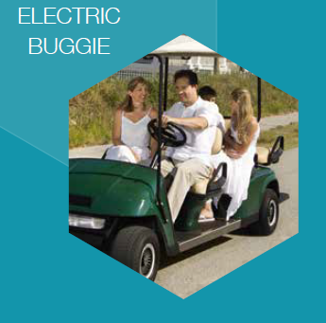
Transportation
Limited vehicular access to the outer perimeter ring road and parking lots only. This means internal transportation relies on the following:
Zero-emission vehicles, charged by solar panels, and alternative modes of transportation such as:
Electric vehicles - provided to each household
Internal public transport - electric buses
Bicycles and segways
EV Charging stations provided across the city
Subsidy for an electric car for each household
Electric shuttle bus connecting the City to the nearest metro station (Mall of Emirates)

Slide 26
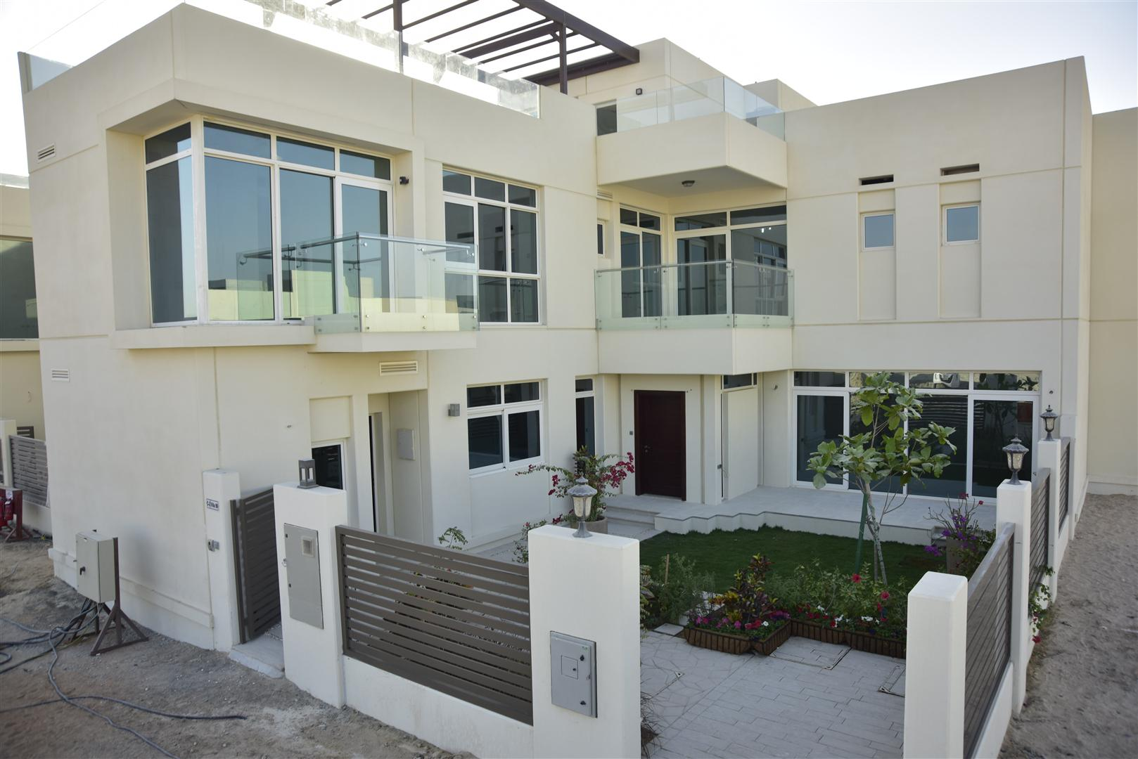
Project Delivery Timeline
Phase 1 Completion: 3rd Quarter 2015
The Green Belt Buffer Zone
Equestrian Center
The Central Green Spine
Residential clusters 1-5
Community Mall
All utilities
Phase 2 Completion : 4th Quarter 2016
Eco-Resort
Country Club
School
Science Museum & Planetarium
Sustainability Center of Excellence

Slide 27
The Sustainable City
Thank You

